Slide 1


Presentation By Team 7
Building a LAMP Stack Web Application
15 . 10 . 2024

Slide 2







Team
Members
Name
MOHIT
KAVYA
SHUPTA
VARUN
YUVARAJ

Slide 3












Introduction
In this project, we developed a web application using the LAMP stack—Linux, Apache, MariaDB, and PHP—designed to facilitate user registration and profile management.
http://98.84.23.45/register.php

Slide 4






Definition of LAMP
Project Architecture
Development Process
Challenges Faced
Key Features of App
Today’s
Focus
Deployment on AWS
Conclusion

Slide 5




LAMP stands for -
Linux: Operating system
Apache: Web server
MariaDB: Database management system
Definition
of
LAMP
PHP: Programming language
LAMP used to develop static or dynamic
websites and web applications.
2. It is a open source & collections of tools
used to deliver custom web applications.
3. Flexible, and widely used.

Slide 6
Client Layer:
Users interact with the web application through a
browser. Frontend built with HTML, CSS.
2. Web Server Layer (Apache):
Hosts the application and serves web pages to users.
Handles HTTP requests and responses.
3. Application Layer (PHP):
Processes business logic. Handles user input and
interacts with the database.
4. Database Layer (MariaDB):
Stores user data, including registration details and
profiles.
5. Hosting:
Deployed on AWS EC2 for scalability and reliability
Project Architecture

Slide 7
Planning: Define requirements and design architecture.
Setup: Configure AWS EC2 and install LAMP stack.
Development: Implement PHP backend and HTML/CSS frontend.
Testing: Perform unit and integration testing.
Deployment: Deploy on AWS EC2 and monitor performance.
Maintenance: Address feedback and update regularly.
Development Process

Slide 8
Common Issues :
Configuration challenges with AWS services.
Managing database connectivity and security.
Ensuring responsive design across devices.
2. Solutions Implemented :
Research and collaboration for troubleshooting.
Code Review: Conducted peer reviews to ensure code quality and adherence to best practices.
Documentation: Created comprehensive documentation for the setup process and user guides to facilitate easier onboarding and troubleshooting.
Challenges Faced

Slide 9







User Registration and Login
Profile Management
Data Storage and Retrieval
Responsive Design
Key Features of the Application

Slide 10






Steps to Deploy :
Set up an EC2 instance.
Configure Apache and MySQL.
Deploy the PHP application.
2. Tools Used :
AWS Management Console, Search Engine etc.
Deployment on AWS

Slide 11
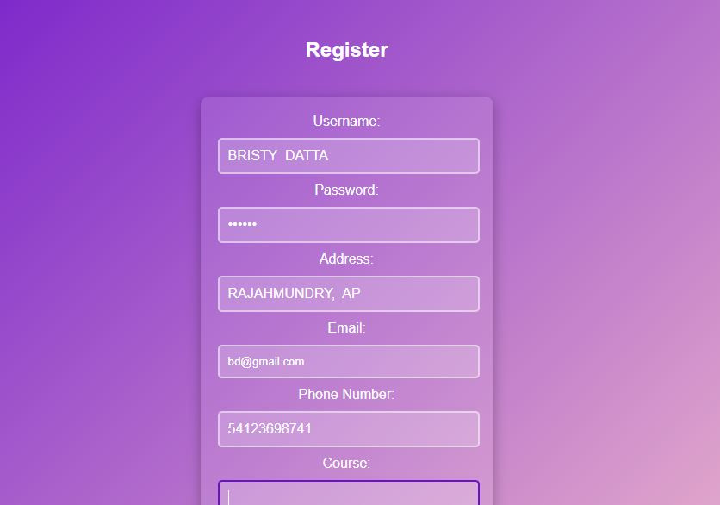
OUTPUT - 01
Registration Page

Slide 12
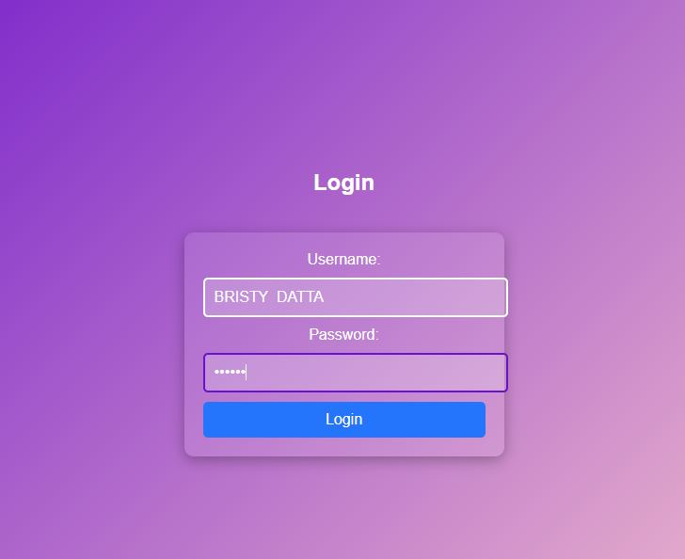
OUTPUT - 02
Login Page

Slide 13
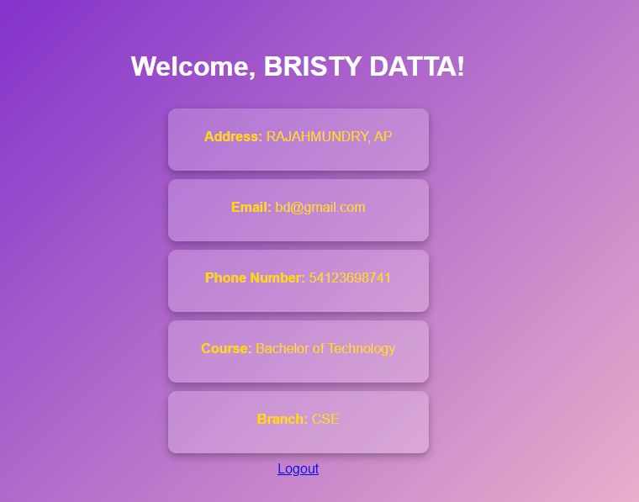
OUTPUT - 03
Dashboard Page

Slide 14
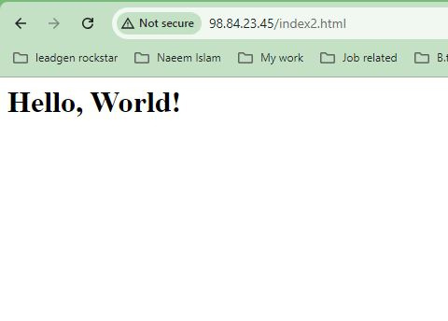
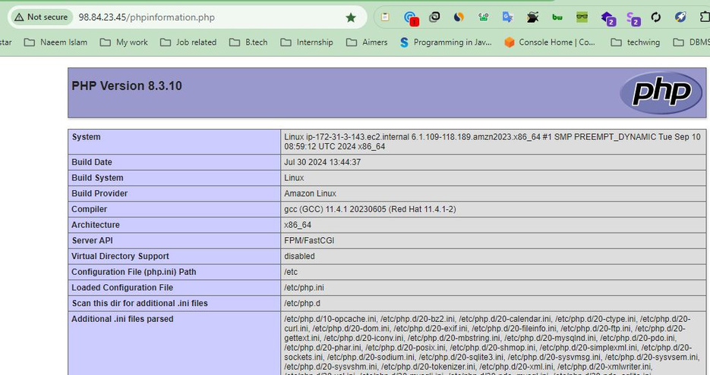
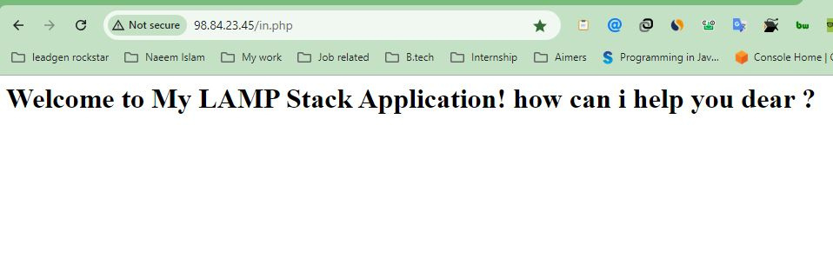
OTHER OUTPUTS
index.html
phpinformation.php
in.php

Slide 15
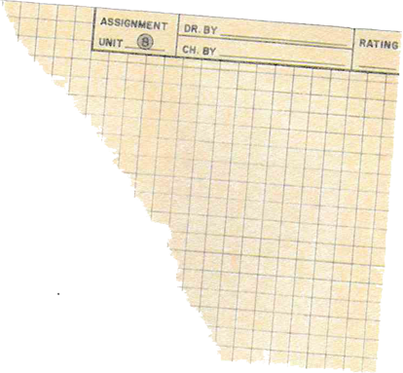

Conclusion
Summary of Achievements :
Successful deployment and functionality of the web app.
Implementation of user registration and login features.
Secure handling of user data with password hashing.
Effective troubleshooting .
Positive user feedback during testing phases.
Enhanced teamwork and collaboration skills within the group.

Slide 16


Thank you.
Feel free to approach us ,if you have any question.
http://98.84.23.45/dashboard.php

